Slide 1
Platform
Any hardware or software environment in which a program runs, is known as a platform
Java has a runtime environment (JRE) and API(Application Program interface) it is called a platform

Slide 2
class keyword is used to declare a class in Java.
public keyword is an access modifier that represents visibility. It means it is visible to all
static is a keyword. If we declare any method as static, it is known as the static method. The core advantage of the static method is that there is no need to create an object to invoke the static method. The main() method is executed by the JVM, so it doesn't require creating an object to invoke the main() method. So, it saves memory
void is the return type of the method. It means it doesn't return any value
main represents the starting point of the program
String[] args or String args[] is used for command line argument.
System.out.println() is used to print statement. Here, System is a class, out is an object of the PrintStream class, println() is a method of the PrintStream class

Slide 3
Platform Independent
Java is a write once, run anywhere language
Java provides a software-based platform.
Runs on top of other hardware-based platforms.
It has two components:
Runtime Environment
API(Application Programming Interface)

Slide 4
I want to Make software for School/college
A
Demo Base Product

Slide 5
Features
Budget
Contract with cmpany
GDPR

Slide 6
Technical ppl/Architects
Decide whtr it is possible decide
HR Understand

Slide 7
HTml,css,angular,javascript,react,jquery
Front end team
Merge/Integration
Testing team
.net/java/phython , database, spring, hibernate, rest…n
Backend team

Slide 8
Teste product
Product stage is working
Support/Devops team
UAT limited no users
SIT
Staging
Integrated
Enviornment for usage of the tested product

Slide 9
In software bugs are some issues , issing functionaliy, which need to fix by the developer
Deliver the phase 1 of the project

Slide 10
Agile model
Waterfall model

Slide 11
Flow of Java programe
Java compiler converts the source code into byte code.
Java code
Bytecode
Compiler
.java
.class

Slide 12
JDK Installation Path
https://www.oracle.com/in/java/technologies/javase/javase8-archive-downloads.html

Slide 13
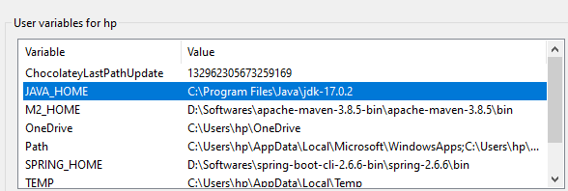
Set up

Slide 14
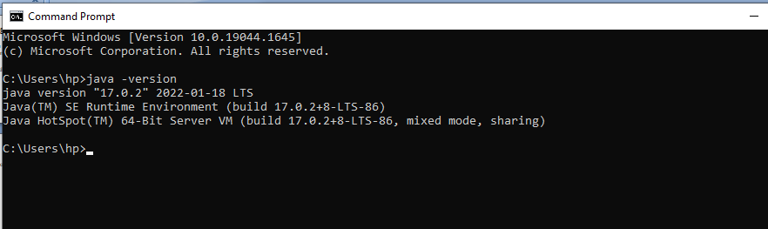
To Identify Jdk, Java compiler version

Slide 15
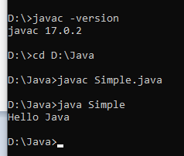
Compile the program from Terminal/Command Prompt

Slide 16
Diff ways to Initiate
public static void main(String[] args)
public static void main(String []args)
public static void main(String args[])
public static void main(String... args)
static public void main(String[] args)
public static final void main(String[] args)
final public static void main(String[] args)

Slide 17
JDK,JRE,JVM
JDK (Java Development Kit) is a Kit that provides the environment to develop and execute(run) the Java program. JDK is a kit(or package) that includes two things
Development Tools(to provide an environment to develop your java programs)
JRE (to execute your java program)
JRE (Java Runtime Environment) is an installation package that provides an environment to only run(not develop) the java program(or application)onto your machine. JRE is only used by those who only want to run Java programs that are end-users of your system.
JVM Java virtual memory is a very important part of both JDK and JRE because it is contained or inbuilt in both. Whatever Java program you run using JRE or JDK goes into JVM and JVM is responsible for executing the java program line by line, hence it is also known as an interpreter
JIT in Java is an integral part of the JVM. It accelerates execution performance many times over the previous level

Slide 18
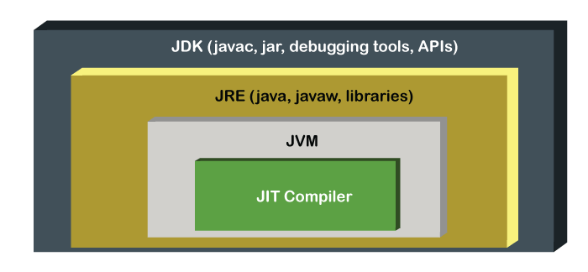

Slide 19
Install Eclipse IDE Corresponding to Java 8 Version
https://www.eclipse.org/downloads/packages/release/neon/3/eclipse-ide-java-ee-developers
Git-https://git-scm.com/
Tortoise Git -https://tortoisegit.org/download/
Sighn up an account in git-> https://github.com/

Slide 20
Semantic Error
this type of error appears. These types of error are detected at compile time.
Most of the compile time errors are scope and declaration error
Example
int a = "hello";

Slide 21
Syntax Error
Syntax errors are a type of compiler error. This means they will be detected immediately when the programmer tries to convert his source code into a program

Slide 22
Phases
Compile time
Run time
Every time you run a Java program, the Java compiler creates a .class file from the Java source code file.
The Java Virtual Machine(JVM) then loads the .class file and executes the main method, which is the entry point for the Java application
This is one of the reasons why it is absolutely necessary to have a main method for classes where you have executable code

Slide 23
A class file contains the Java bytecode and has a ".class" extension
This file is what the Java Virtual Machine (JVM) interprets and converts into machine code
The class file(.class) is used by the JVM and not meant for your specific operating system

Slide 24
The source code file has file extension ". java
The extension name of a Java class file is .class

Slide 25
End Of Module 2
Thank You

